Slide 1

Unit- 4
Process-to-Process Delivery: UDP, TCP
Dr. Kamlesh Chandravanshi
School of Computer Science & Engineering

Slide 2
1 PROCESS-TO-PROCESS DELIVERY
The transport layer is responsible for process-to- process delivery—the delivery of a packet, part of a message, from one process to another. Two processes communicate in a client/server relationship, as we will see later.
Topics discussed in this section: Client/Server Paradigm Multiplexing and Demultiplexing
Connectionless Versus Connection-Oriented Service Reliable Versus Unreliable
Three Protocols

Slide 3

Note
The transport layer is responsible for process-to-process delivery.

Slide 4
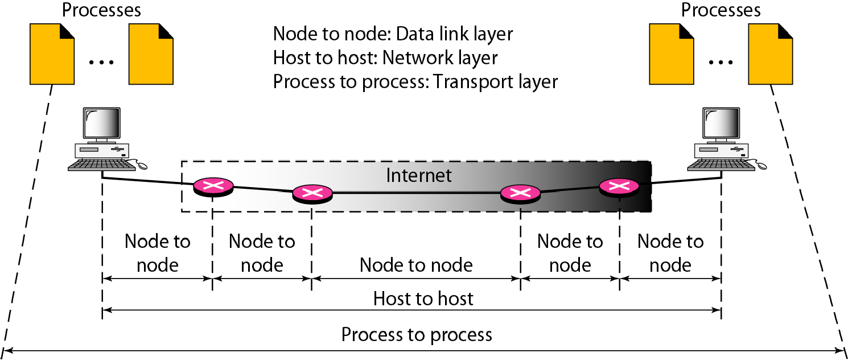
Figure 1 Types of data deliveries

Slide 5
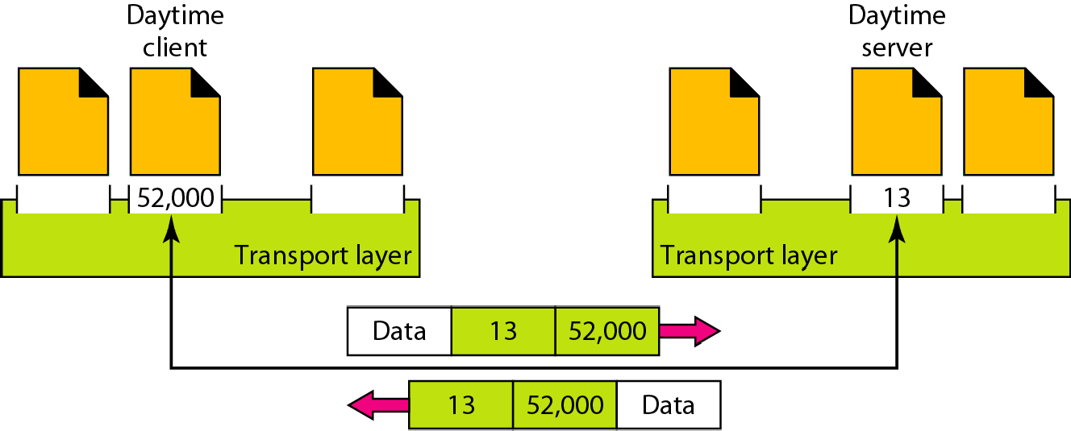
Figure 2 Port numbers

Slide 6
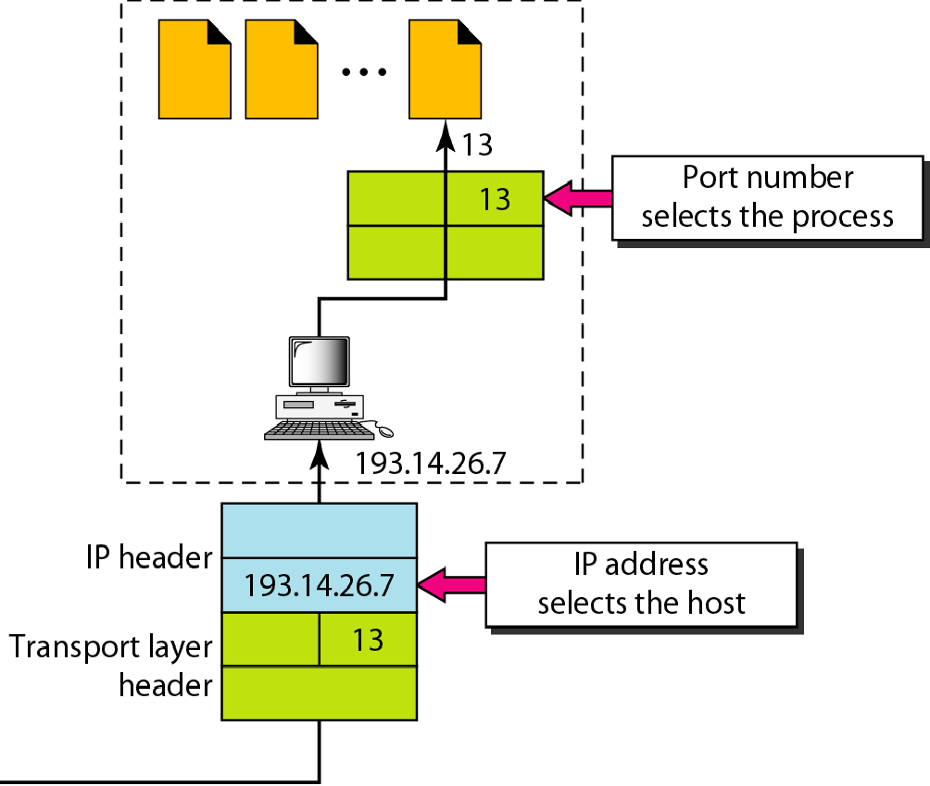
Figure 3 IP addresses versus port numbers

Slide 7
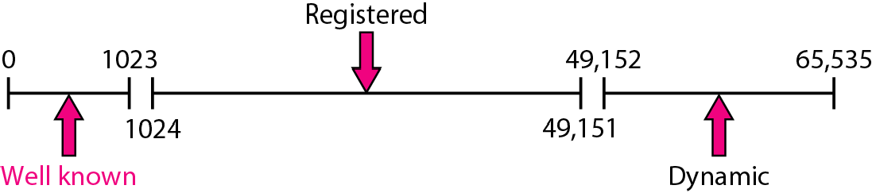
Figure 4 IANA ranges

Slide 8
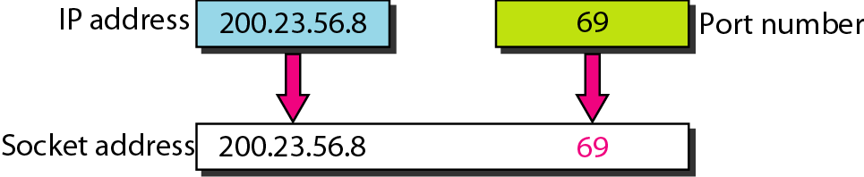
Figure 5 Socket address

Slide 9
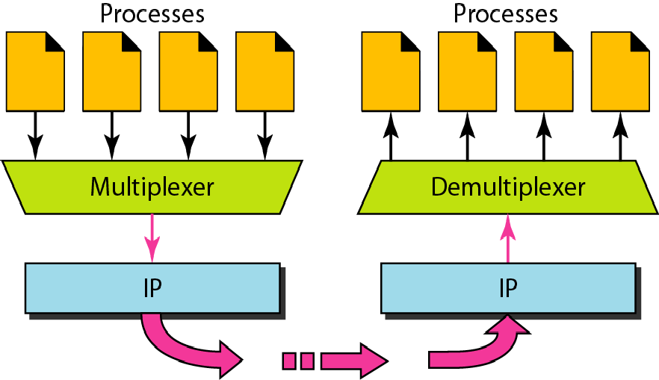
Figure 6 Multiplexing and demultiplexing

Slide 10
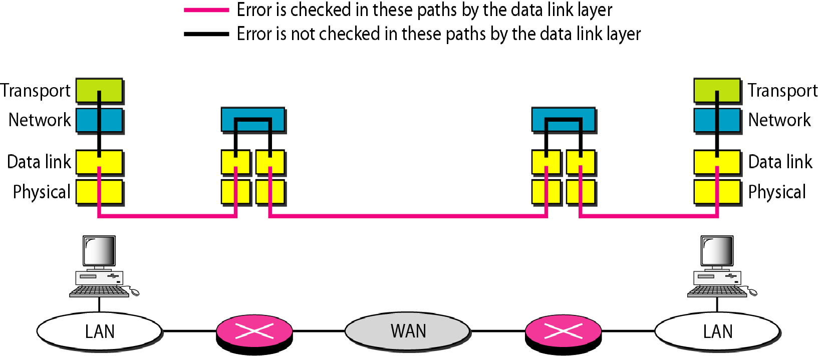
Figure 7 Error control

Slide 11
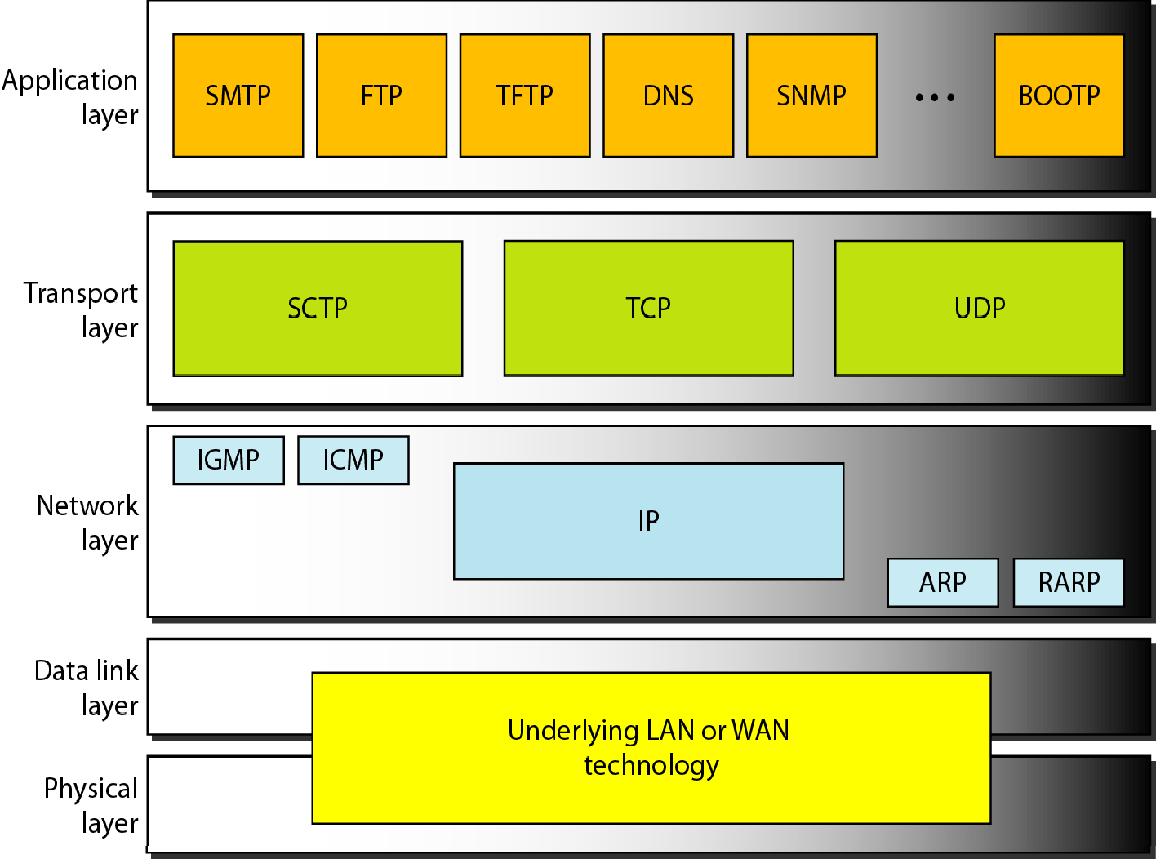
Figure 8 Position of UDP, TCP, and SCTP in TCP/IP suite

Slide 12
2 USER DATAGRAM PROTOCOL (UDP)
The User Datagram Protocol (UDP) is called a connectionless, unreliable transport protocol. It does not add anything to the services of IP except to provide process-to-process communication instead of host-to- host communication.
Topics discussed in this section:
Well-Known Ports for UDP User Datagram
Checksum UDP Operation Use of UDP

Slide 13
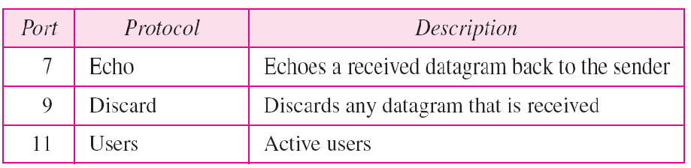
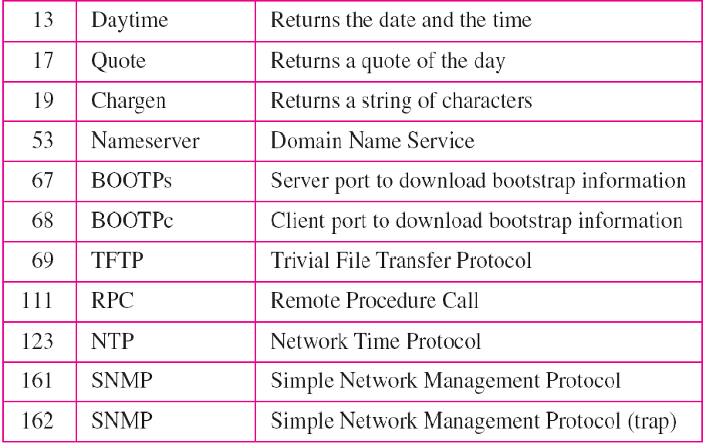
Table 1 Well-known ports used with UDP

Slide 14
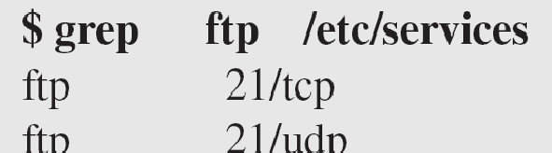
Example 1
In UNIX, the well-known ports are stored in a file called
/etc/services Each line in this file gives the name of the server and the well-known port number. We can use the grep utility to extract the line corresponding to the desired application. The following shows the port for FTP. Note that FTP can use port 21 with either UDP or TCP

Slide 15
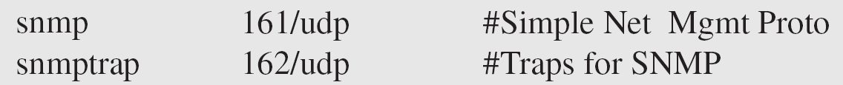
Example 1 (continued)
SNMP uses two port numbers (161 and 162), each for a different purpose.

Slide 16
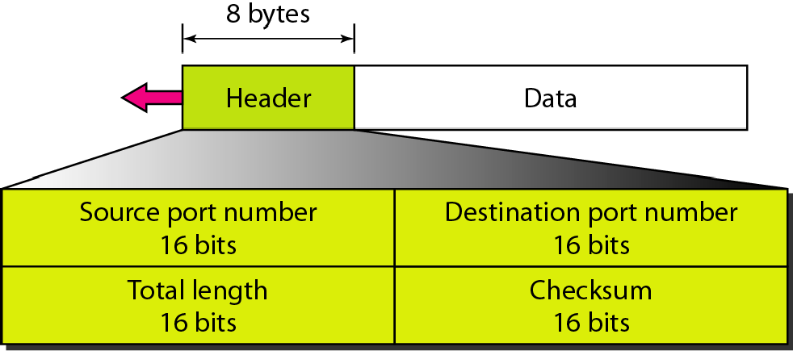
Figure 9 User datagram format

Slide 17
Note
UDP length
= IP length – IP header’s length

Slide 18
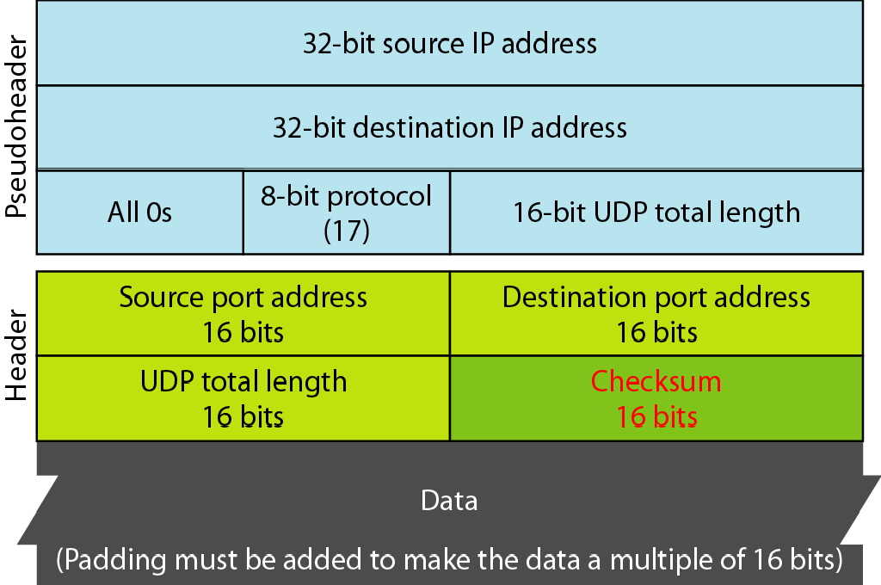
Figure 10 Pseudoheader for checksum calculation

Slide 19
Example 2
Figure 11 shows the checksum calculation for a very small user datagram with only 7 bytes of data. Because the number of bytes of data is odd, padding is added for checksum calculation. The pseudoheader as well as the padding will be dropped when the user datagram is delivered to IP.

Slide 20
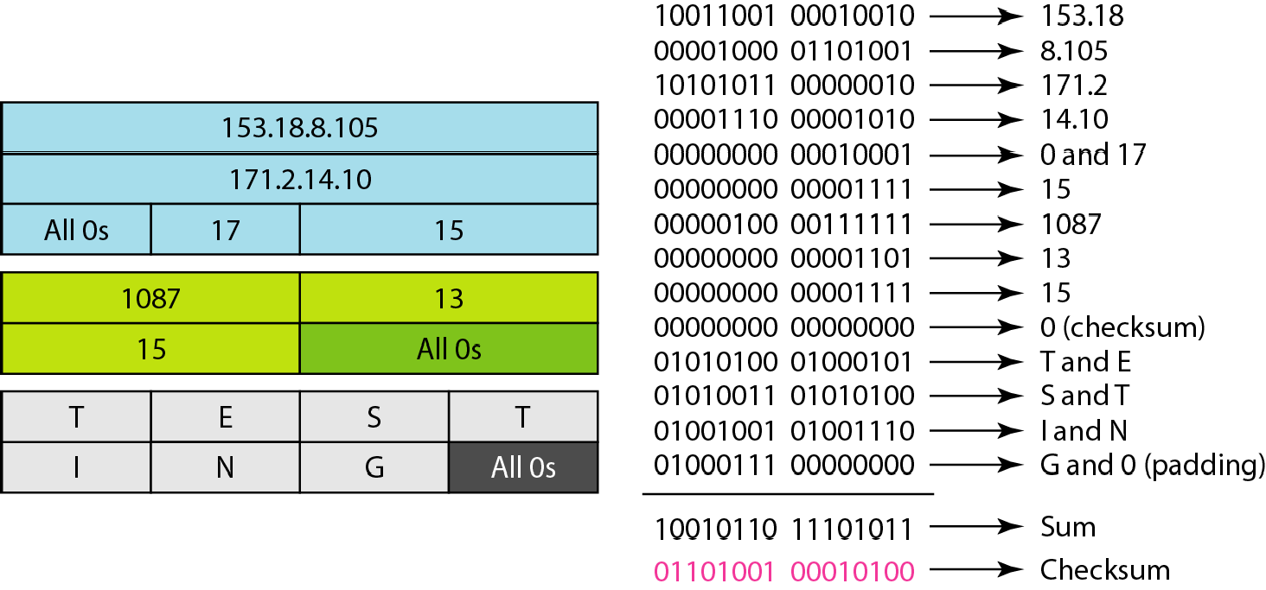
Figure 11 Checksum calculation of a simple UDP user datagram

Slide 21
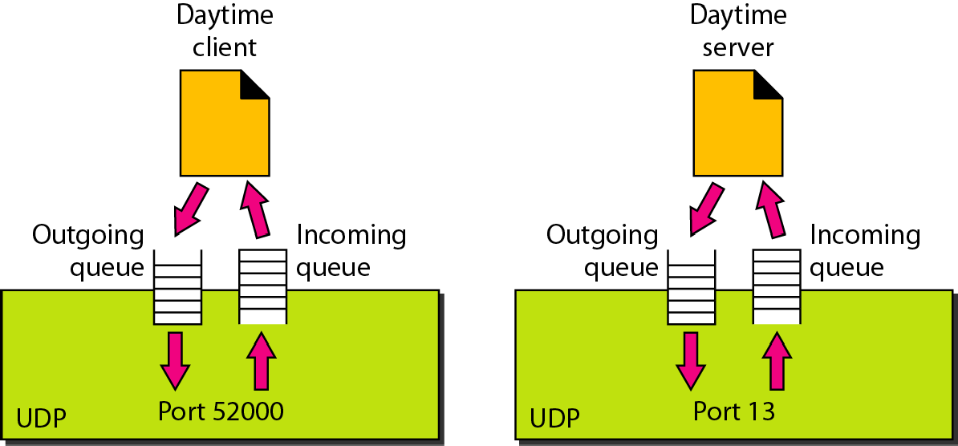
Figure 12 Queues in UDP

Slide 22
3 TCP
TCP is a connection-oriented protocol; it creates a virtual connection between two TCPs to send data. In addition, TCP uses flow and error control mechanisms at the transport level.
Topics discussed in this section:
TCP Services TCP Features Segment
A TCP Connection Flow Control Error Control

Slide 23
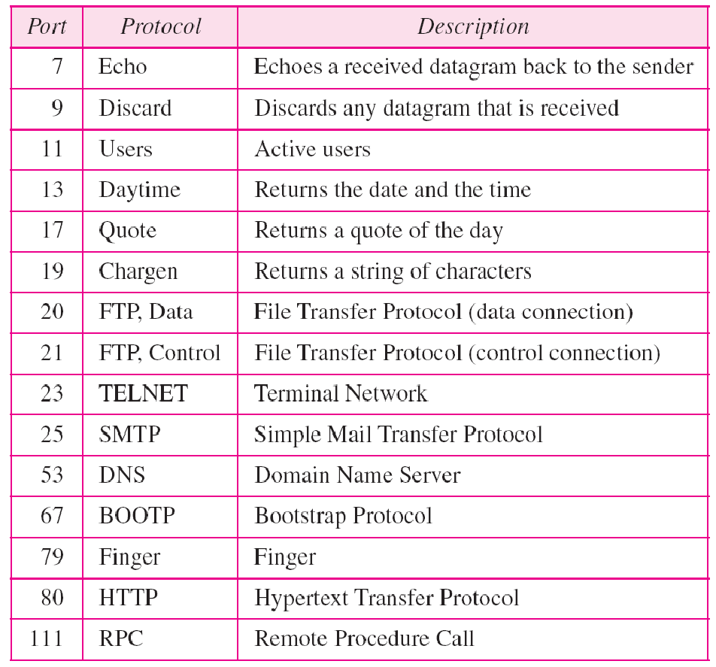
Table 2 Well-known ports used by TCP

Slide 24
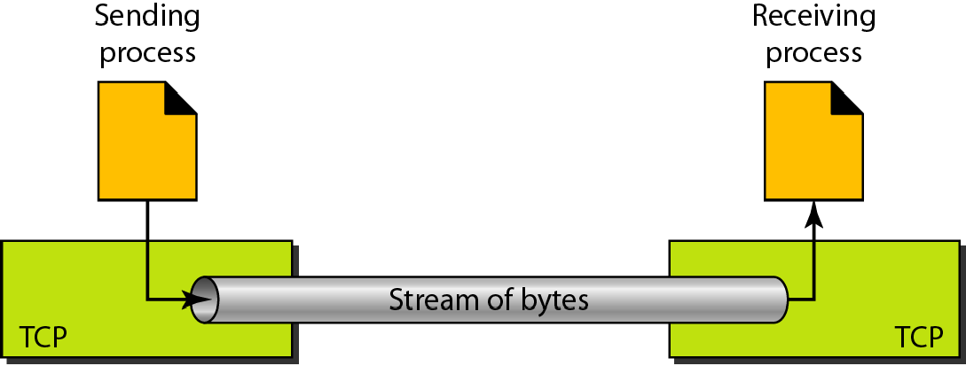
Figure 13 Stream delivery

Slide 25
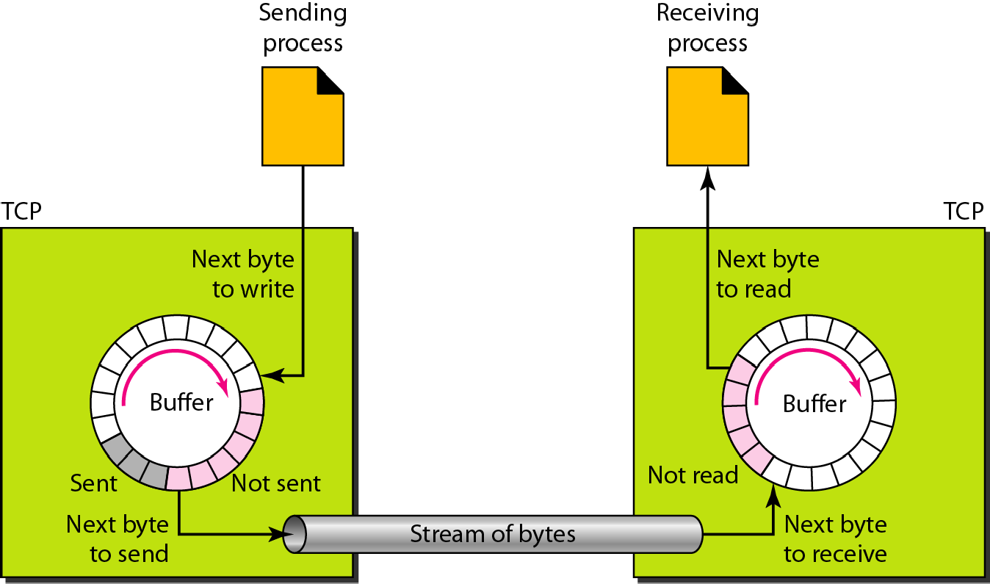
Figure 14 Sending and receiving buffers

Slide 26
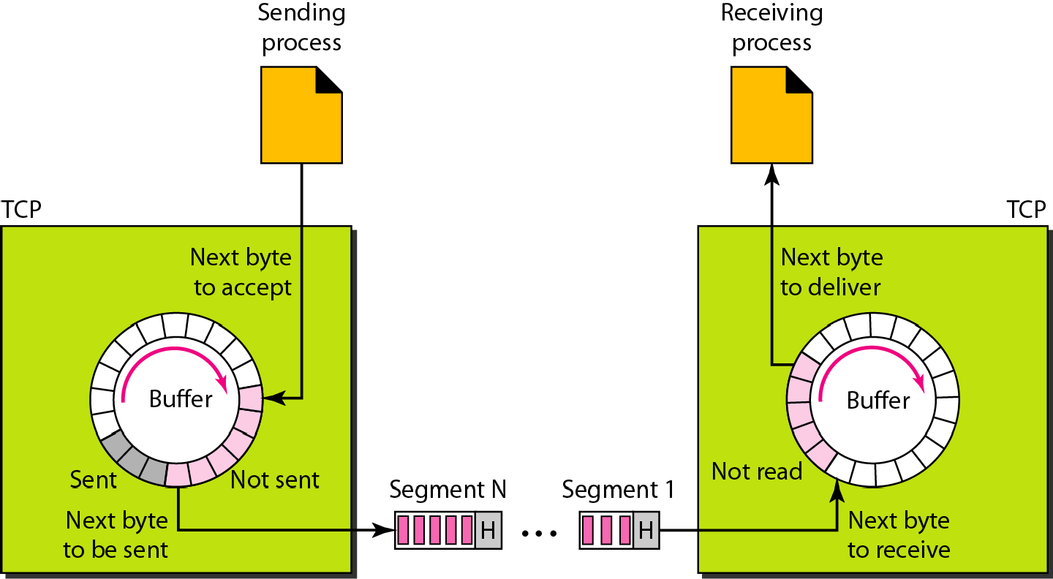
Figure 15 TCP segments

Slide 27
Note
The bytes of data being transferred in each connection are numbered by TCP. The numbering starts with a randomly generated number.

Slide 28
Example 3
The following shows the sequence number for each segment:

Slide 29

Note
The value in the sequence number field of a segment defines the
number of the first data byte contained in that segment.

Slide 30

Note
The value of the acknowledgment field in a segment defines
the number of the next byte a party expects to receive.
The acknowledgment number is cumulative.

Slide 31
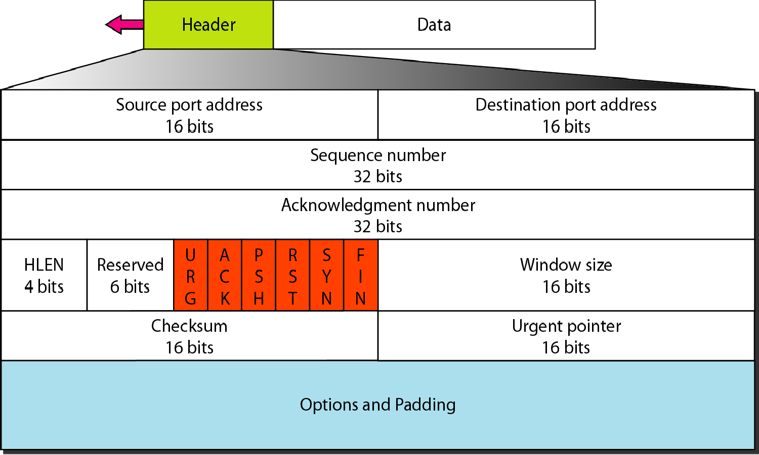
Figure 16 TCP segment format

Slide 32
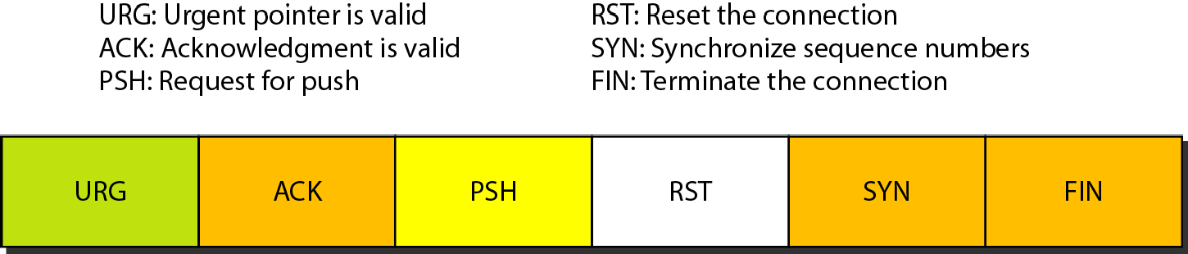
Figure 17 Control field

Slide 33
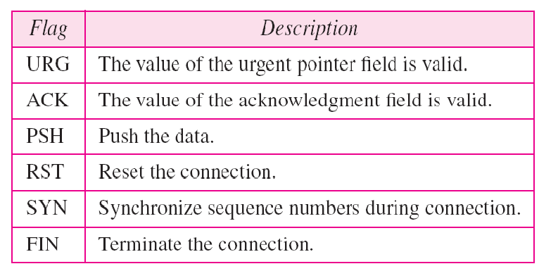
Table 3 Description of flags in the control field

Slide 34
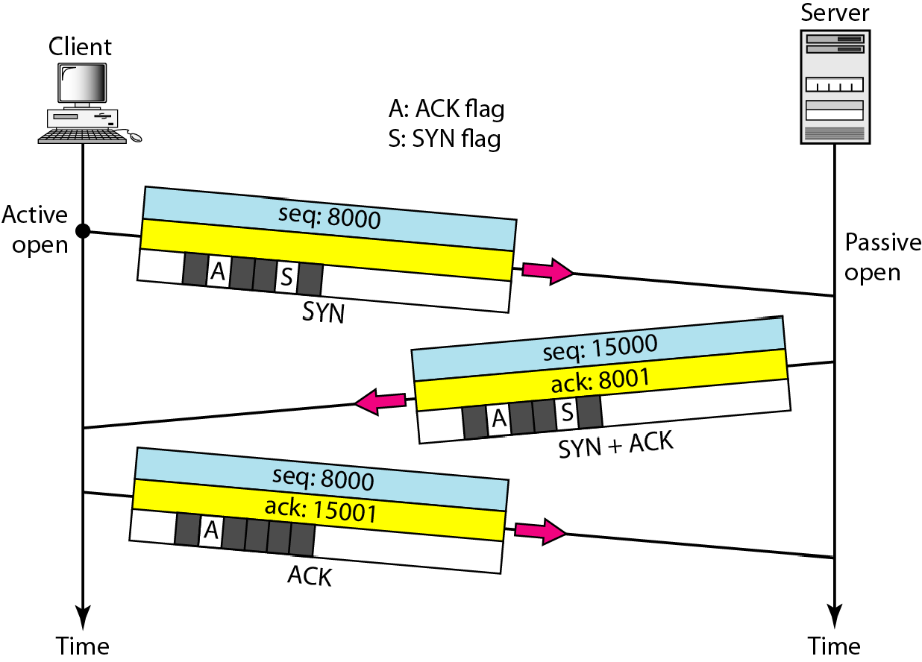
Figure 18 Connection establishment using three-way handshaking

Slide 35
Note
A SYN segment cannot carry data, but it consumes one sequence number.

Slide 36
Note
A SYN + ACK segment cannot carry data, but does consume one sequence number.

Slide 37
Note
An ACK segment, if carrying no data, consumes no sequence number.

Slide 38
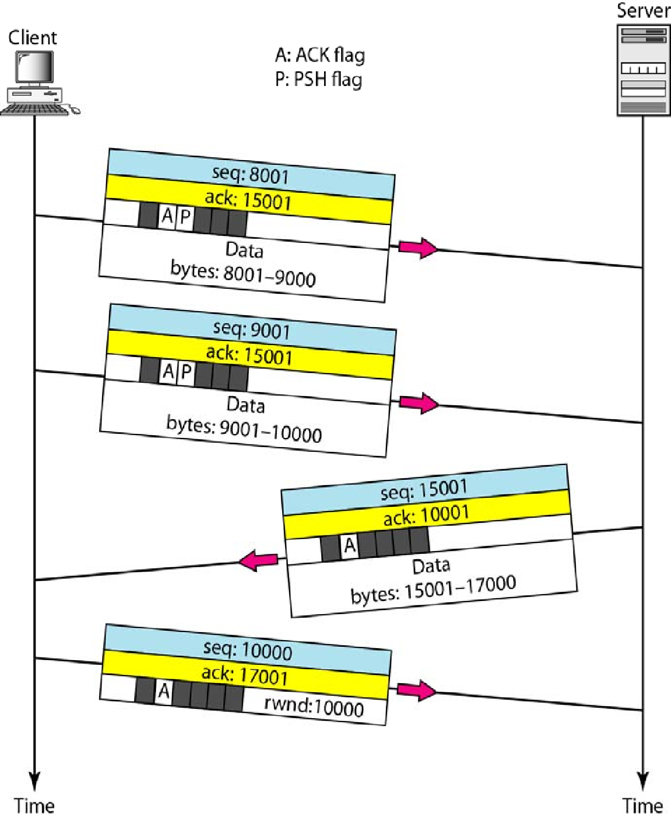
Figure 19 Data transfer

Slide 39
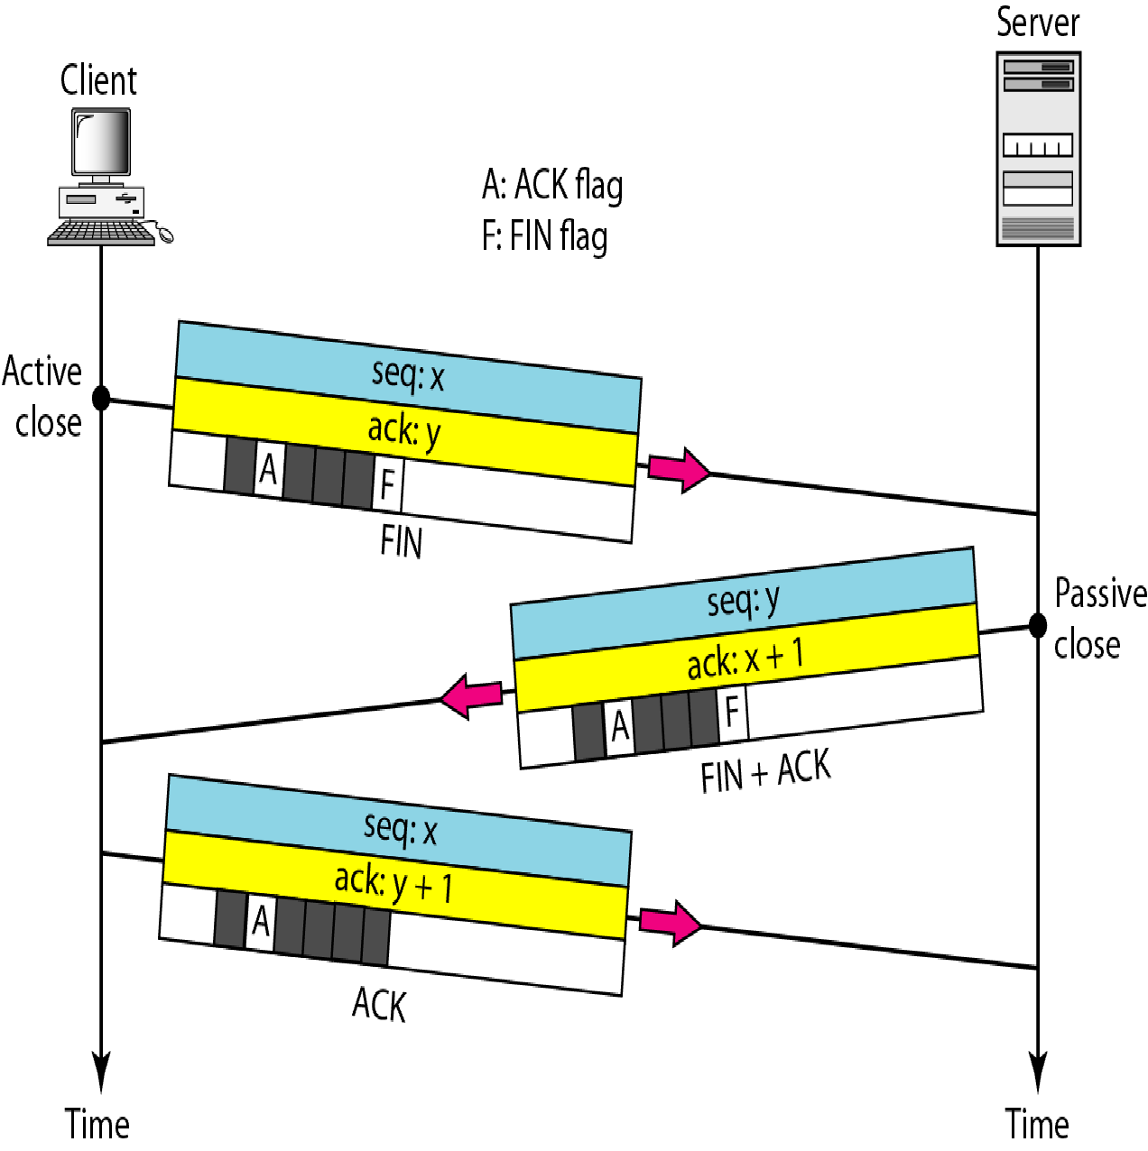
Figure 20 Connection termination using three-way handshaking

Slide 40
Note
The FIN segment consumes one sequence number if it does
not carry data.

Slide 41
Note
The FIN + ACK segment consumes one sequence number if it
does not carry data.

Slide 42
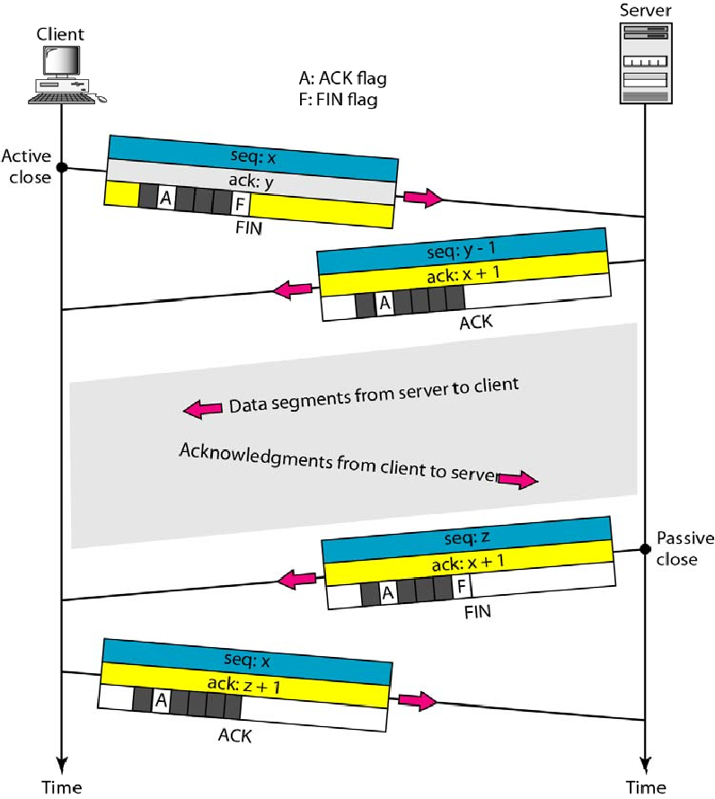
Figure 21 Half-close

Slide 43
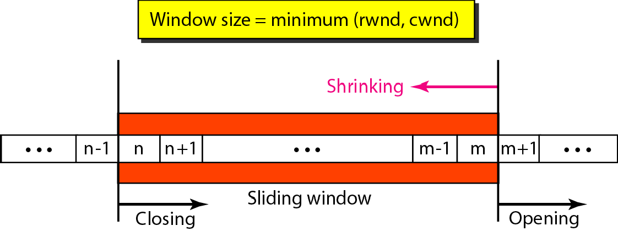
Figure 22 Sliding window

Slide 44

Note
A sliding window is used to make transmission more efficient as well as to control the flow of data so that the destination does not become overwhelmed with data.
TCP sliding windows are byte-oriented.

Slide 45
Example 4
What is the value of the receiver window (rwnd) for host A if the receiver, host B, has a buffer size of 5000 bytes and 1000 bytes of received and unprocessed data?
Solution
The value of rwnd = 5000 − 1000 = 4000. Host B can receive only 4000 bytes of data before overflowing its buffer. Host B advertises this value in its next segment to A.

Slide 46
Example 5
What is the size of the window for host A if the value of rwnd is 3000 bytes and the value of cwnd is 3500 bytes?
Solution
The size of the window is the smaller of rwnd and cwnd, which is 3000 bytes.

Slide 47
Example 6
Figure 23 shows an unrealistic example of a sliding window. The sender has sent bytes up to 202. We assume that cwnd is 20 (in reality this value is thousands of bytes). The receiver has sent an acknowledgment number of 200 with an rwnd of 9 bytes (in reality this value is thousands of bytes). The size of the sender window is the minimum of rwnd and cwnd, or 9 bytes. Bytes 200 to 202 are sent, but not acknowledged. Bytes 203 to 208 can be sent without worrying about acknowledgment. Bytes 209 and above cannot be sent.

Slide 48
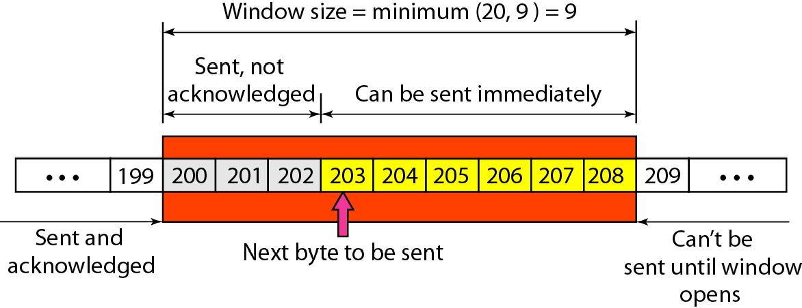
Figure 23 Example 6

Slide 49
Note
Some points about TCP sliding windows:
❏ The size of the window is the lesser of rwnd and cwnd.
❏ The source does not have to send a full window’s worth of data.
❏ The window can be opened or closed by the receiver, but should not be shrunk.
❏ The destination can send an acknowledgment at any time as long as it does not result in a shrinking
window.
❏ The receiver can temporarily shut down the window; the sender, however, can always send a segment of 1 byte after the window is shut down.

Slide 50
Note
ACK segments do not consume sequence numbers and are not acknowledged.

Slide 51
Note
In modern implementations, a retransmission occurs if the retransmission timer expires or three duplicate ACK segments have arrived.

Slide 52
Note
No retransmission timer is set for an ACK segment.

Slide 53
Note
Data may arrive out of order and be temporarily stored by the receiving TCP, but TCP guarantees that no out-of-order segment is delivered to the process.

Slide 54
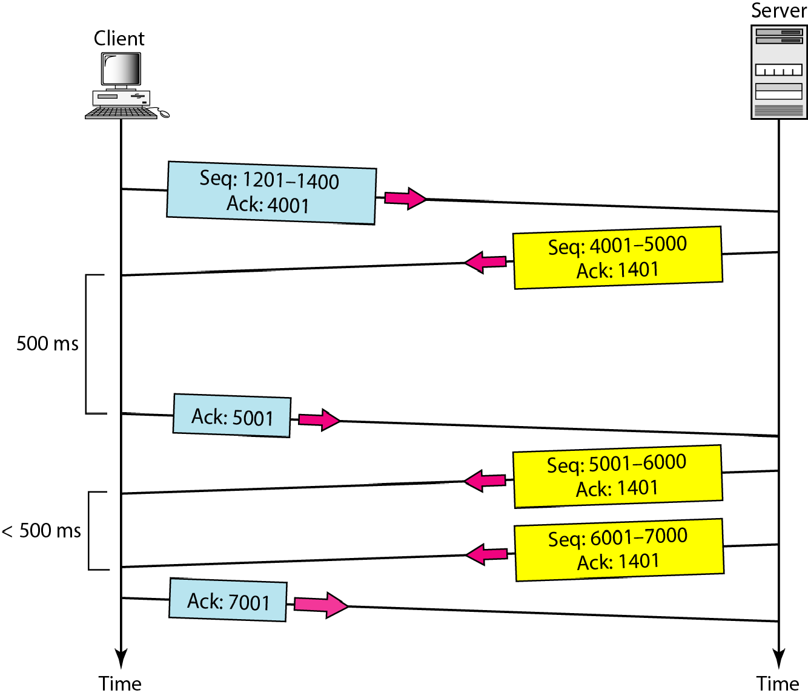
Figure 24 Normal operation

Slide 55
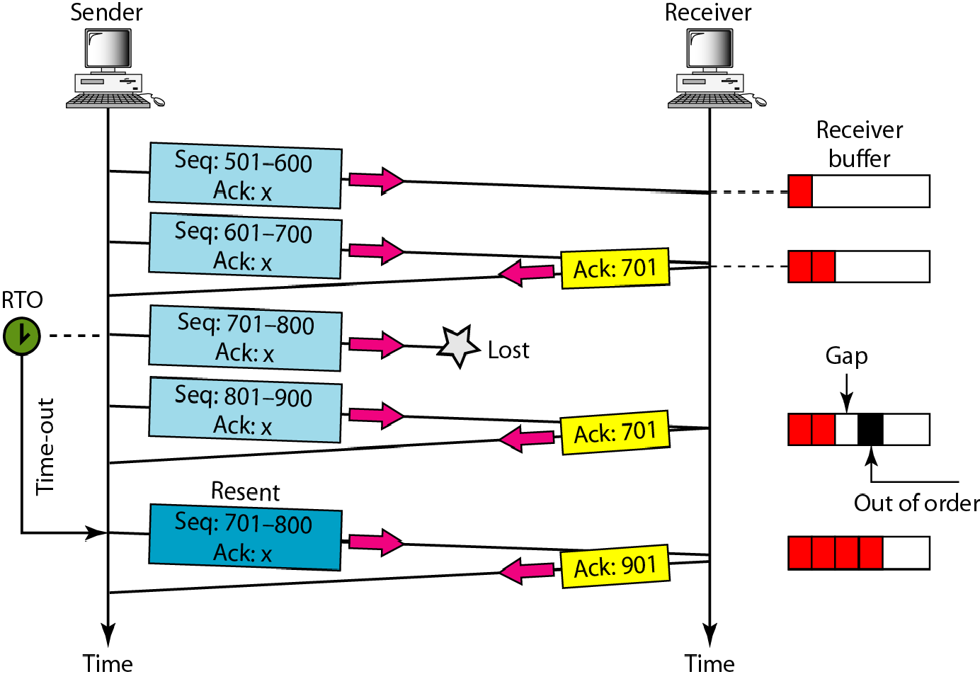
Figure 25 Lost segment

Slide 56
Note
The receiver TCP delivers only ordered data to the process.

Slide 57
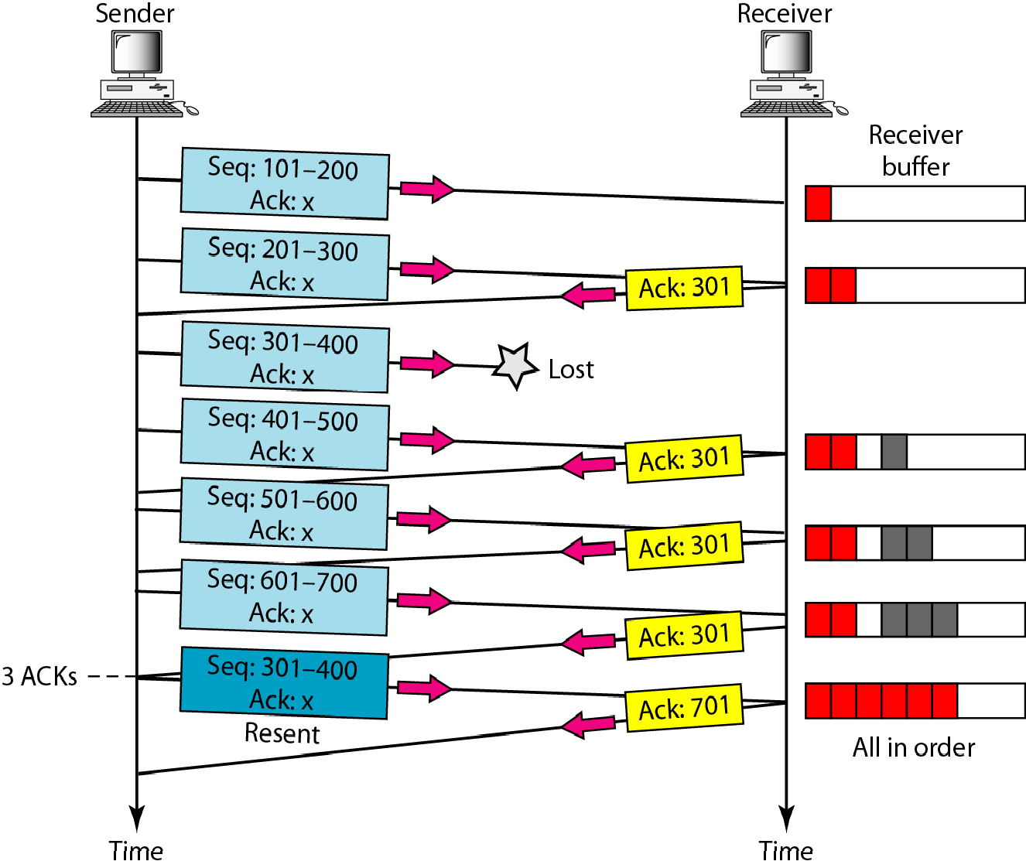
Figure 26 Fast retransmission

